Slide 1
Chapter 3
3.3: Rectangle Collisions

Slide 2
3.3 Collision between non-aligned Rectangles
Broad-phase
Circle bound collision
EASY
Axis-aligned Bbox
Bound interersection
EASY
Now …

Slide 3
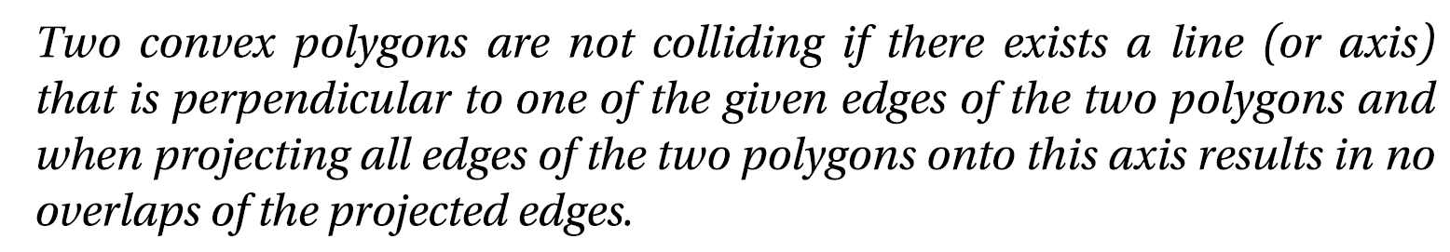
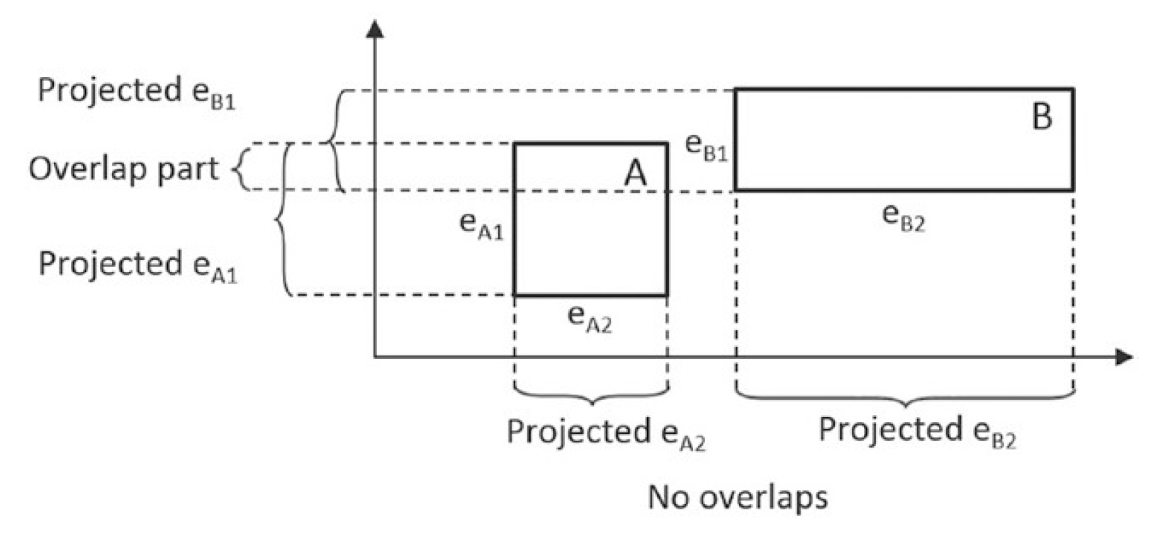
Separating Axis Theorem (SAT)

Slide 4
SAT in English
Given two convex polygons,
Iterate through each edge of the two polygones
Extend the edge to infinity
If the extended edge separates the vertices of the two polygons then, the two polygons do not intersect
If none of the edges satisfies the above, then, collision has occurred
Able to exit early if find the edge early in the iteration

Slide 5
SAT Implementation
Implementation
Given two polygons (ANY convex-gons)
Collided = true // ← assume this is true
For each edge (of each gon)
Compute a line that is perpendicular to the edge
Project all other edges onto this line
If the projected edges do not overlap
Collided = false; // The two gons DO NOT collide!
Strength
For non-colliding shapes: early termination
Can terminate as soon as we find the first edge with no overlaps in projection

Slide 6
Apply SAT
Apply SAT for the following edges
What can you conclude?

Slide 7
Apply SAT

Slide 8
Apply SAT
Projected edges overlap
No conclusion can be
made

Slide 9
Apply SAT

Slide 10
Apply SAT
Projected edges DO NOT overlap!
No intersection between the two rectangles!

Slide 11
Apply SAT again
Apply SAT for the following edges
What can you conclude?

Slide 12
Apply SAT
Look at this face

Slide 13
Apply SAT
Edge/face normal

Slide 14
Apply SAT

Slide 15
Apply SAT

Slide 16
Apply SAT
Overlap!
Conclusion?
NOTHING!

Slide 17
Apply SAT
Apply SAT for the following edges
What can you conclude?

Slide 18
Apply SAT
Let’s look at this edge

Slide 19
Apply SAT
Edge/Face normal

Slide 20
Apply SAT

Slide 21
Apply SAT
Again, no conclusion

Slide 22
What about now?

Slide 23
What about now?
Still, no conclusion

Slide 24
What about now?
BUT, if we look at this edge

Slide 25
What about now?
Face normal

Slide 26
What about now?
Project

Slide 27
What about now?
Project
Conclusion?

Slide 28
SAT …
Iterate through ALL face normal
Define a line
Project all edges onto the line
If no overlaps in the projected segements
➔ Conclusion: no collision
Early termination!
If reach the end
Collision

Slide 29
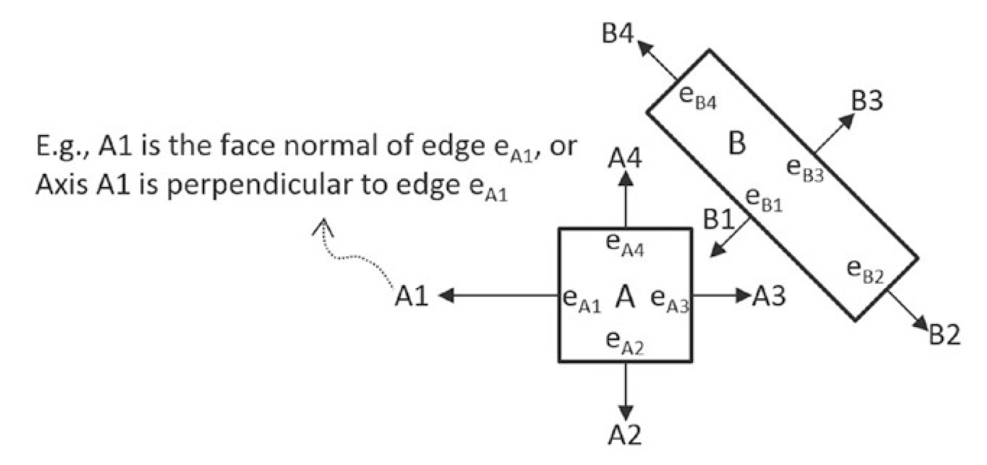
SAT Implementation: Step 1
Compute edge normal (or face normal)

Slide 30
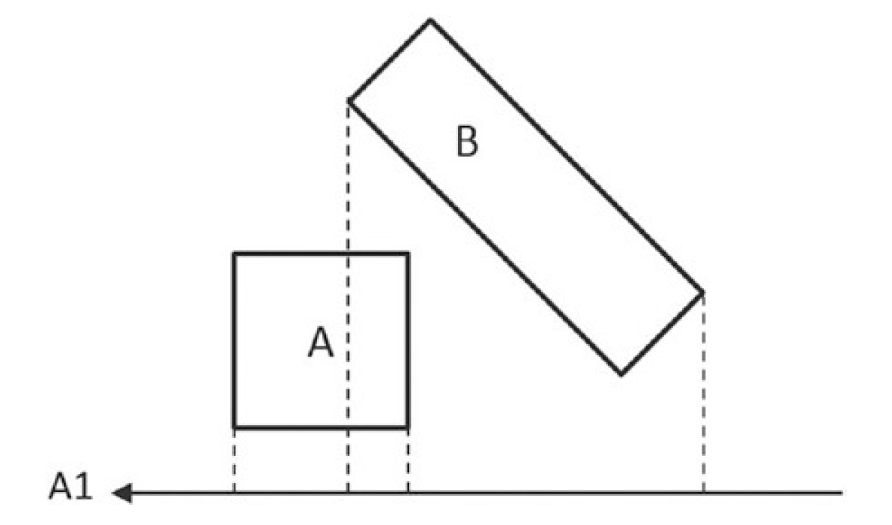
SAT Implementation: Step 2
Project vertices

Slide 31
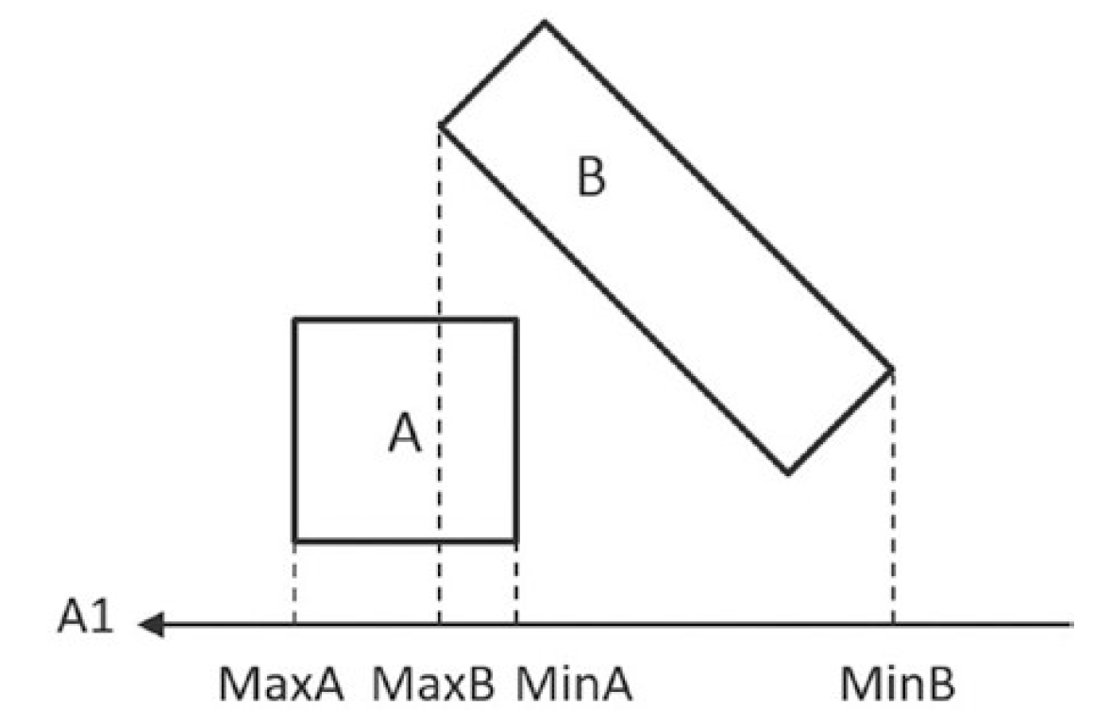
SAT Implementation: Step 3
Establish bounds

Slide 32
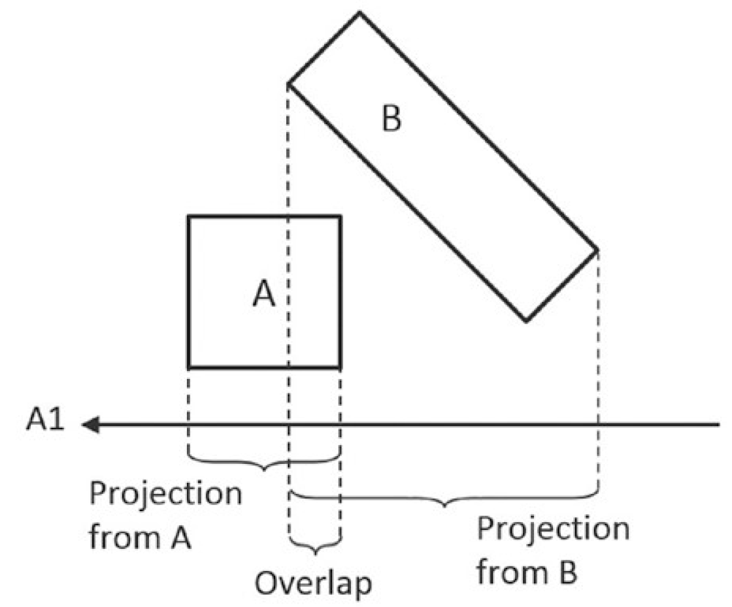
SAT Implementation: Step 4
Determine overlaps

Slide 33
Problem with simple SAT implementation
Only capable of giving yes/no answer!
We need to compute CollisionInfo
Normal, Depth, Start/End points
To resolve interpenetration!

Slide 34
Examine this again
Project to ALL axis

Slide 35
How to resolve overlap?

Slide 36
How to resolve overlap?
Pay attention to the overlaps

Slide 37
How to resolve overlap?

Slide 38
“push out” (along Axis direction)

Slide 39
Can we resolve based on other edges/axes?

Slide 40
Can we resolve based on other edges/axes?

Slide 42
Interesting? Does not quite work?
Notice that … Always push “the other”
Resolved polygon no longer collided with the edge!
But pushed too far!
Two observations:
First. Per-edge operation!!
Resolve in the direction of the axis

Slide 43
Resolve the collision based on SAT results
For the red edge

Slide 44
Resolve the collision based on SAT results

Slide 45
Resolve the collision based on SAT results

Slide 46
Resolve the collision based on SAT results

Slide 47
Implementation Idea
For each edge of this polygon
Compute distances of vertices from the other polygon to this edge
The farthest distance, is the one we must push
One of observation

Slide 48
Implementation Idea
For each edge of this polygon
Compute distances of vertices from the other polygon to this edge
The farthest distance, is the one we must push
One of observation
Only care about overlaps
So, distance is negative (behind the edge)

Slide 49
Support Point: Efficient SAT Implementation
Given two convex polygons: A and B
Support Point
For an edge on A (will use the edge normal) [faceNormal]
For each Vertex on B
Vertex-i on B is a support point for an edge-e on A when
Vertex-i has the MOST NEGATIVE distance from edge-e
Distance measured along the face normal of edge-e
Associated distance: support point distance
Note:
Support point relationship changes for each frame!!

Slide 50
Find all the support points

Slide 51
Find all the support points
Edge-e on A
Vertex-i on B
Distance measured along face normal of Edge-e
Edge-e and face normal

Slide 52
Find all the support points
Edge-e on A
Vertex-i on B
Distance measured along face normal of Edge-e
Edge and face normal
Vertex-i

Slide 53
Find all the support points
Edge-e on A
Vertex-i on B
Distance measured along face normal of Edge-e
Edge and face normal
Vertex-i
Distance measured along face normal
(negative number)

Slide 54
Support point?
Edge-e on A
Vertex-i on B
Distance measured along face normal of Edge-e
Edge and face normal
Vertex-i
Distance measured along face normal
(negative number)

Slide 55
Support point?
Edge-e on A
Vertex-i on B
Distance measured along face normal of Edge-e
Support point is the MOST negative!
Edge and face normal
Vertex-i
Distance measured along face normal
(negative number)

Slide 56
What about this edge?
Edge-e on A
Vertex-i on B
Distance measured along face normal of Edge-e
Support point is the MOST negative!
Edge-e and face normal

Slide 57
What about this edge?
Edge-e on A
Vertex-i on B
Distance measured along face normal of Edge-e
Support point is the MOST negative!
Edge-e and face normal

Slide 58
What about this edge?
This distance is positive?!
Edge-e on A
Vertex-i on B
Distance measured along face normal of Edge-e
Support point is the MOST negative!
Edge-e and face normal

Slide 59
What about this edge?
This distance is positive?!
Edge-e on A
Vertex-i on B
Distance measured along face normal of Edge-e
Support point is the MOST negative!
Edge-e and face normal

Slide 60
Find all the support points

Slide 61
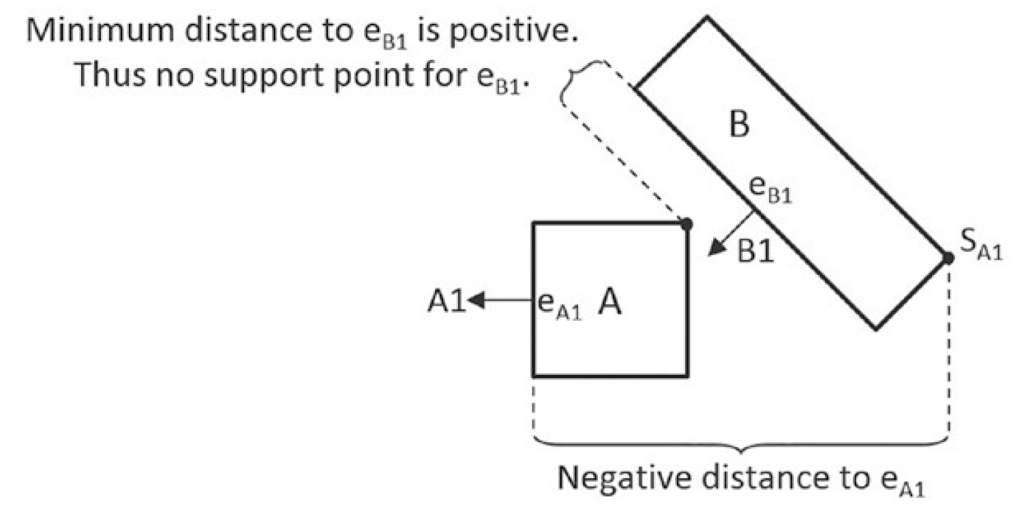
No Support Point:
Vertex-i on B is a support point for an edge-e on A when
Vertex-i has the MOST NEGATIVE distance from edge-e
Distance measured along the normal of edge-e
For edge e_{B1:} no support point
Because A is entirely in front of B
➔ No support points: DO NOT collide
Early termination!
As soon as we find an edge without support points
Implementation note:
Support Distance:
measured along negative normal direction

Slide 62
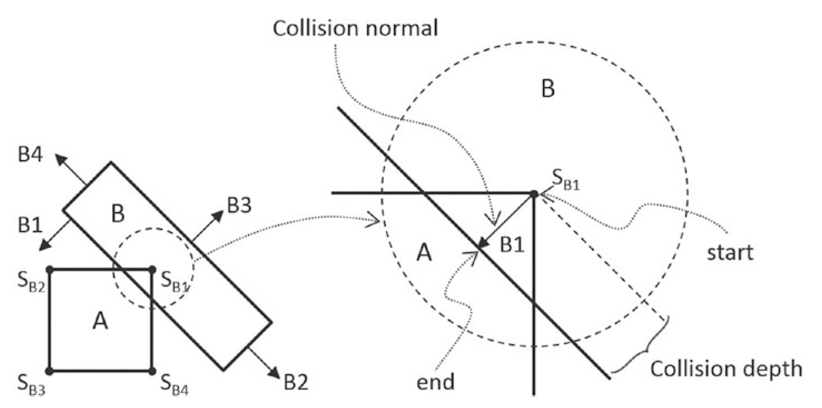
Axis of least penetration
If all support points are defined for all edges of both polygons
Axis of least penetration
The face normal of the smallest support point distance

Slide 63
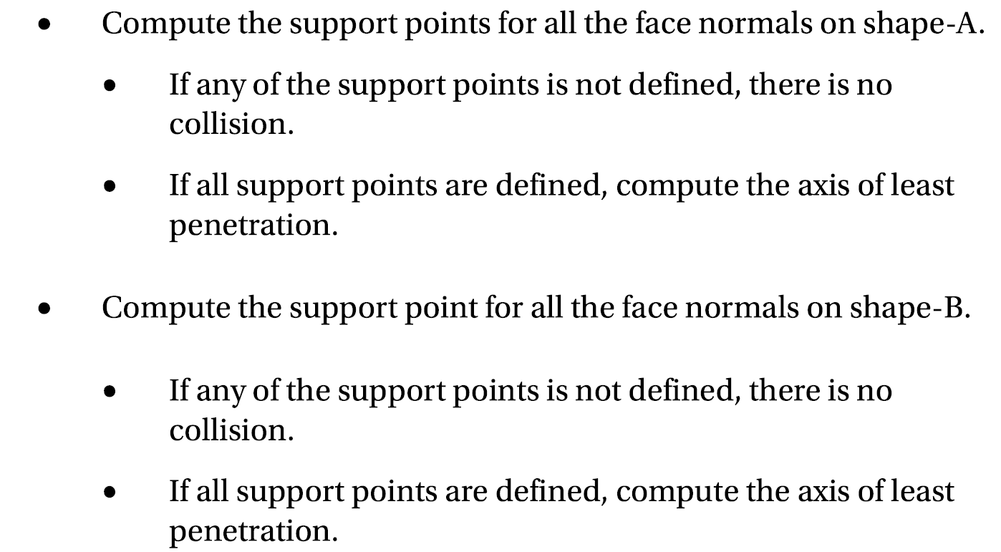
SAT Implementation with Support Point

Slide 64
Axis of least penetration

Slide 65
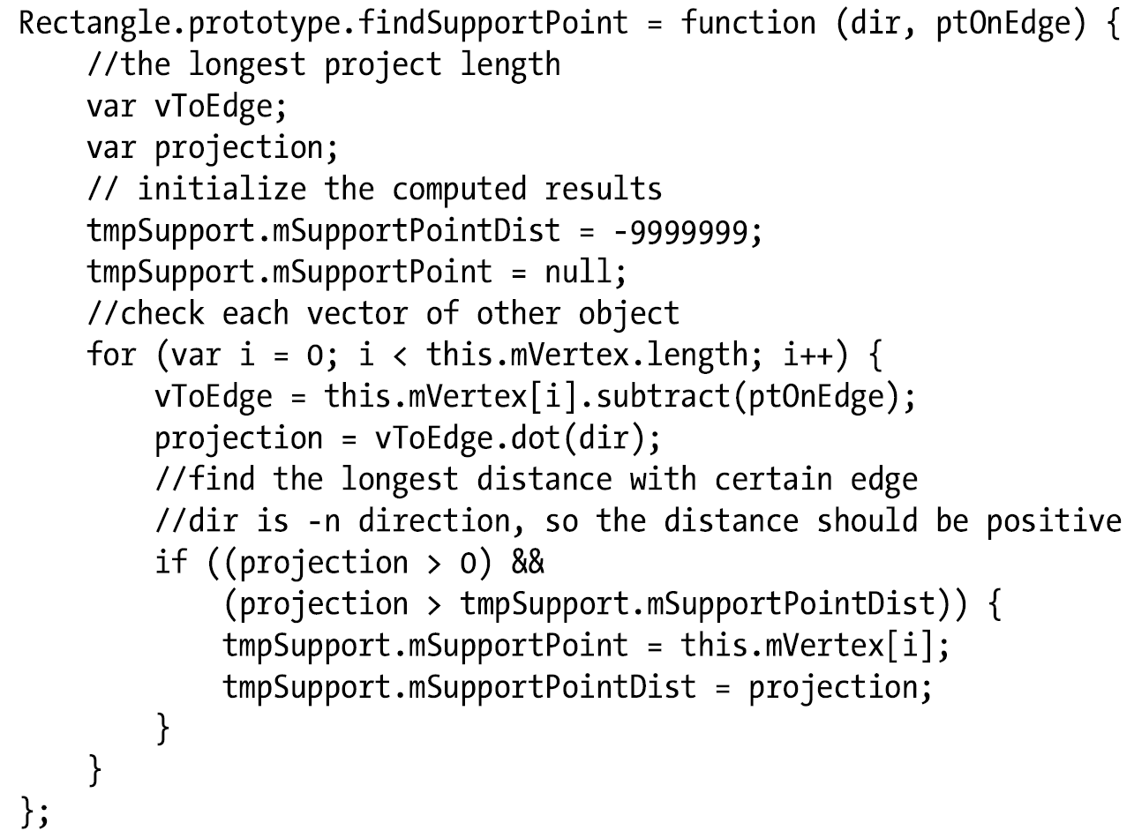
SAT Implementation: FindSupportPoint

Slide 66
SAT Implementation: FindSupportPoint
Input: negative Face normal of other
Input: a vertex on the edge
This: rectangle
-dir

Slide 67
SAT Implementation: FindSupportPoint
This: rectangle
dir
ptOnEdge
vToEdge

Slide 68
SAT Implementation: FindSupportPoint
projection
ptOnEdge
vToEdge

Slide 69
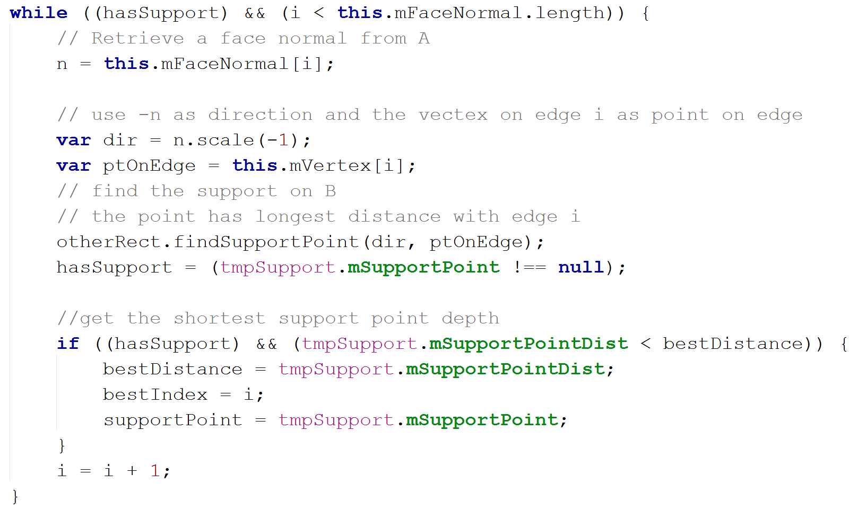
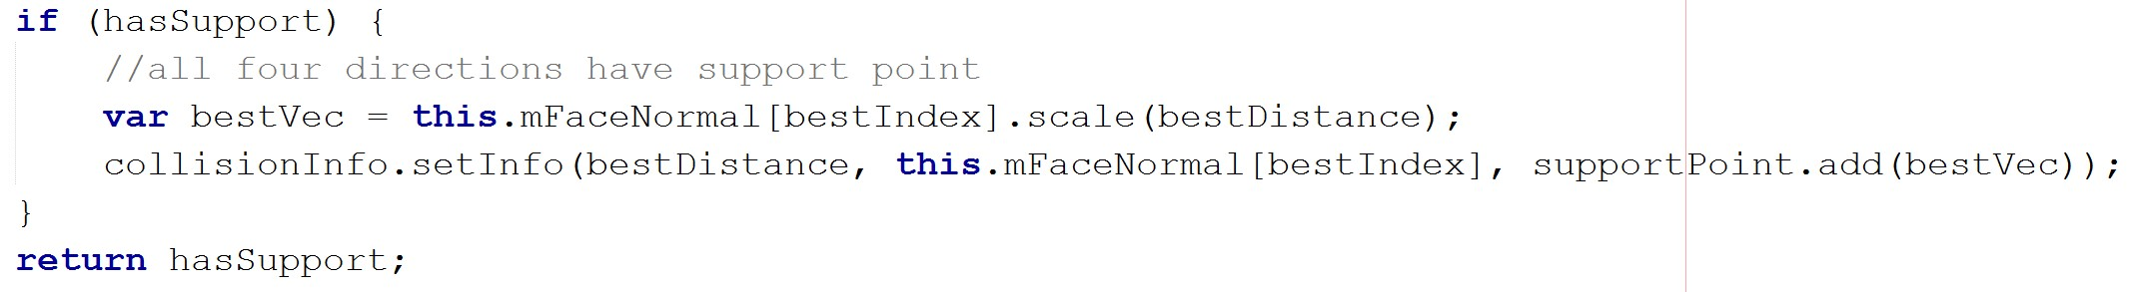
SAT Implementation: Axis of Least Penetration

Slide 70
SAT Implementation: Axis of Least Penetration

Slide 71
SAT Implementation: Axis of Least Penetration

Slide 72
SAT Implementation: Axis of Least Penetration
otherRect

Slide 73
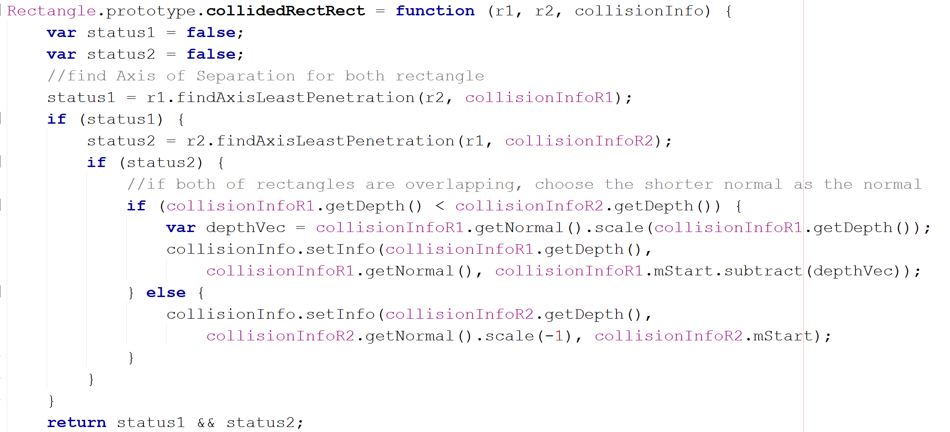
SAT Implementation: everything together

Slide 74
SAT Implementation: everything together
r2 has support points for every edge or r1

Slide 75
SAT Implementation: everything together
For each edge of r1, r2 has a corresponding support point
For each edge of r2, r1 has a corresponding support point

Slide 76
SAT Implementation: everything together
For each edge of r1, r2 has a corresponding support point
For each edge of r2, r1 has a corresponding support point
Choose one with smaller collision depth

